Slide 1

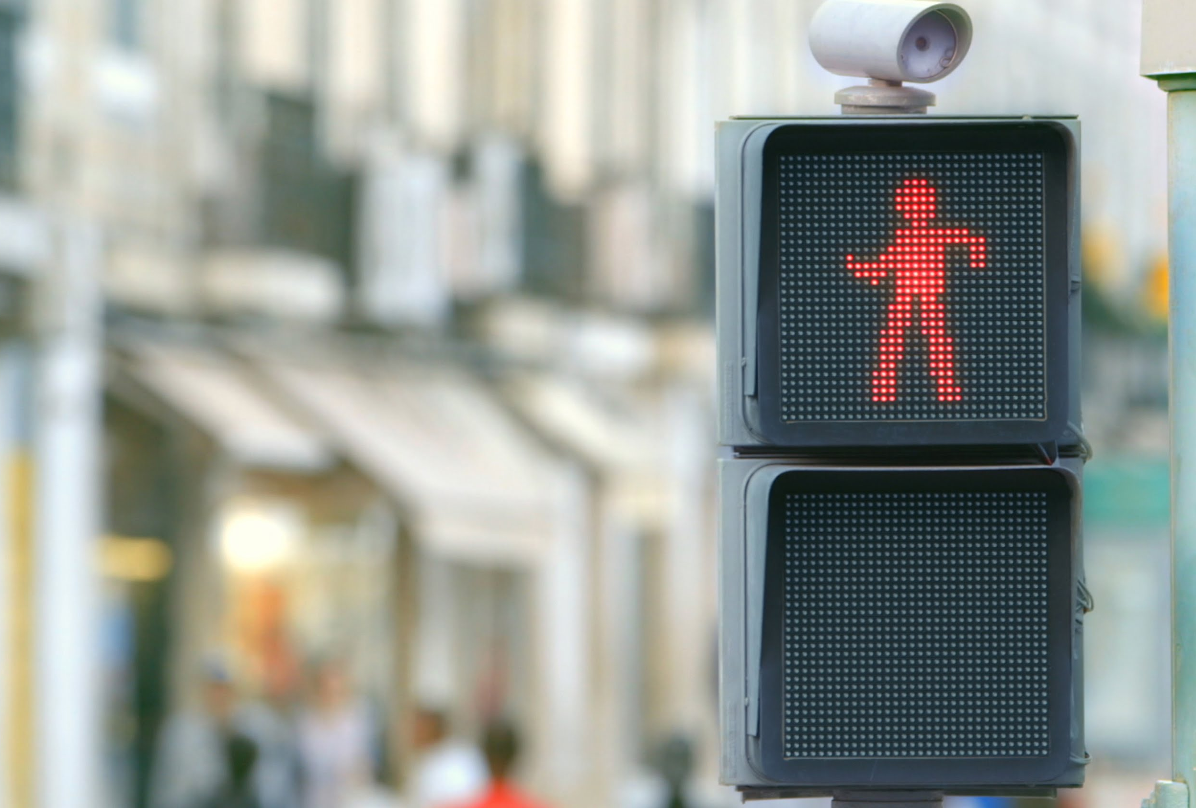
Road Safety (Public Security)
By:
Ketan Khanna
William Wong
Nafe McNafee

Slide 2
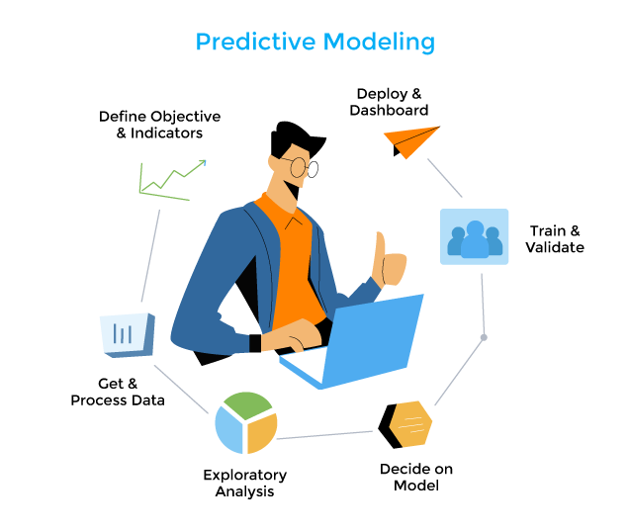
Data Source and Objective
Data Source
Toronto Police Service public safety data portal: Killed or Seriously Injured (KSI) dataset
Data obtained from Kaggle:
https://data.torontopolice.on.ca/datasets/TorontoPS::ksi/explore?location=43.790169%2C-79.369666%2C11.16&showTable=true
KSI dataset collected since 2006
Only for accidents in Toronto
Objective
Create predictive models that can determine the severity of injury (target) in an accident depending on the circumstances of the vehicle collision (features).

Slide 3
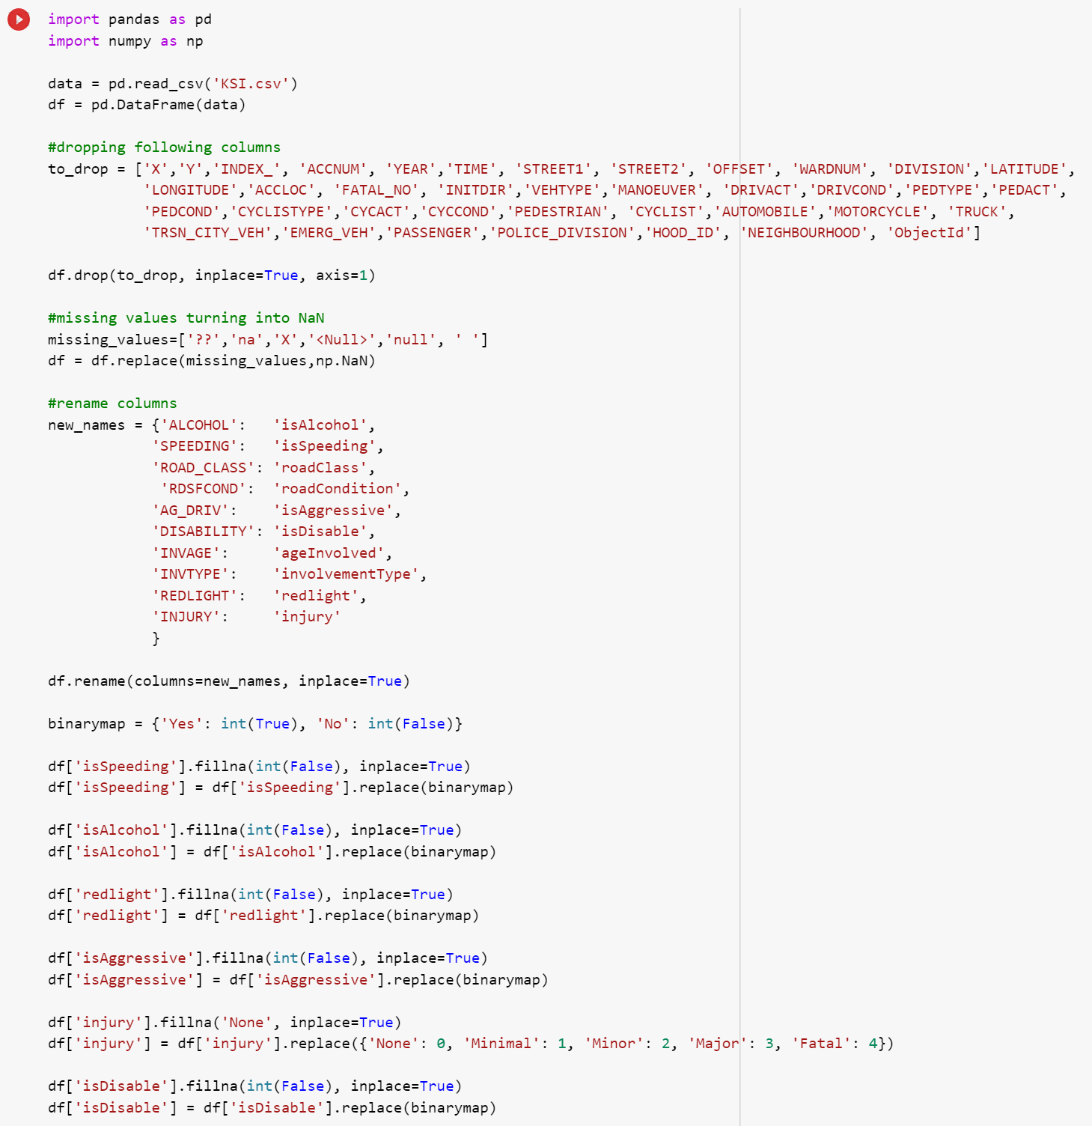

Data Cleanup
Identify necessary features and drop unnecessary variables
Proceeded to rename certain features to allow simplicity of use
Due to most of the features being categorical, we replaced any missing/null values with NaN
Realization: Binary features: null values are False
Categorize non-binary feature values

Slide 4
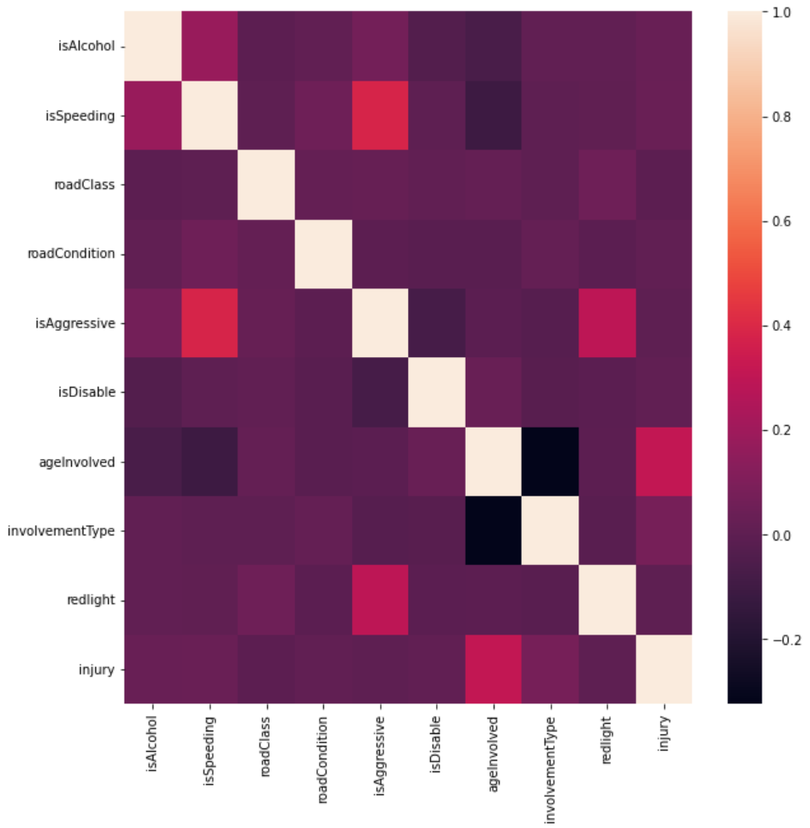
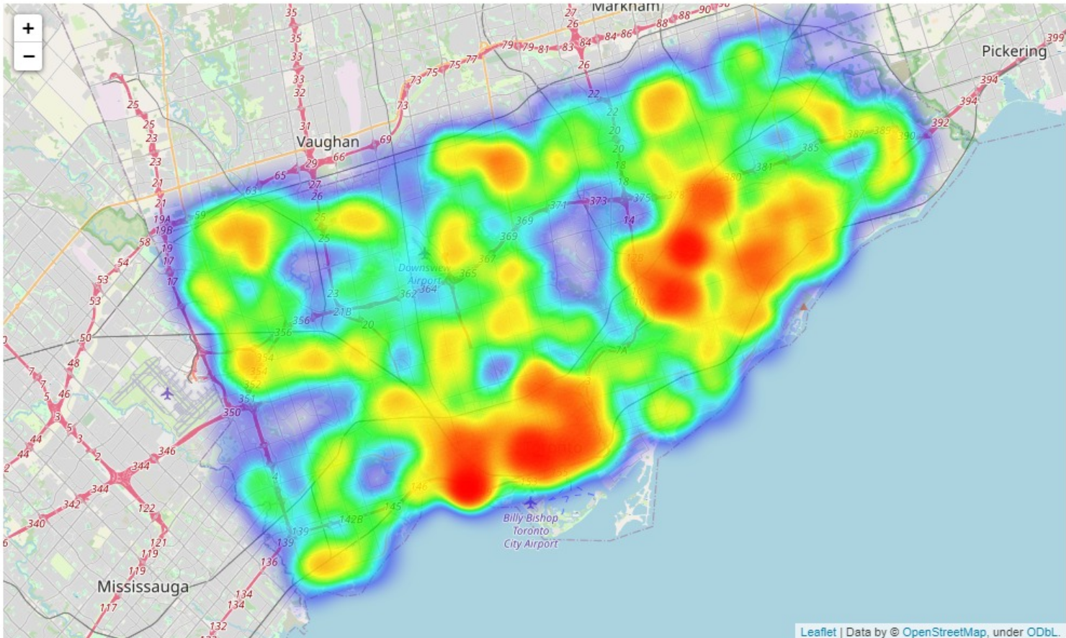
Data Exploration
Creating a correlation matrix for all features
City Heat Map (geo) showing the # of fatalities in each district
Correlation amongst binary features. Relationships are observed amongst a few variables.

Slide 5
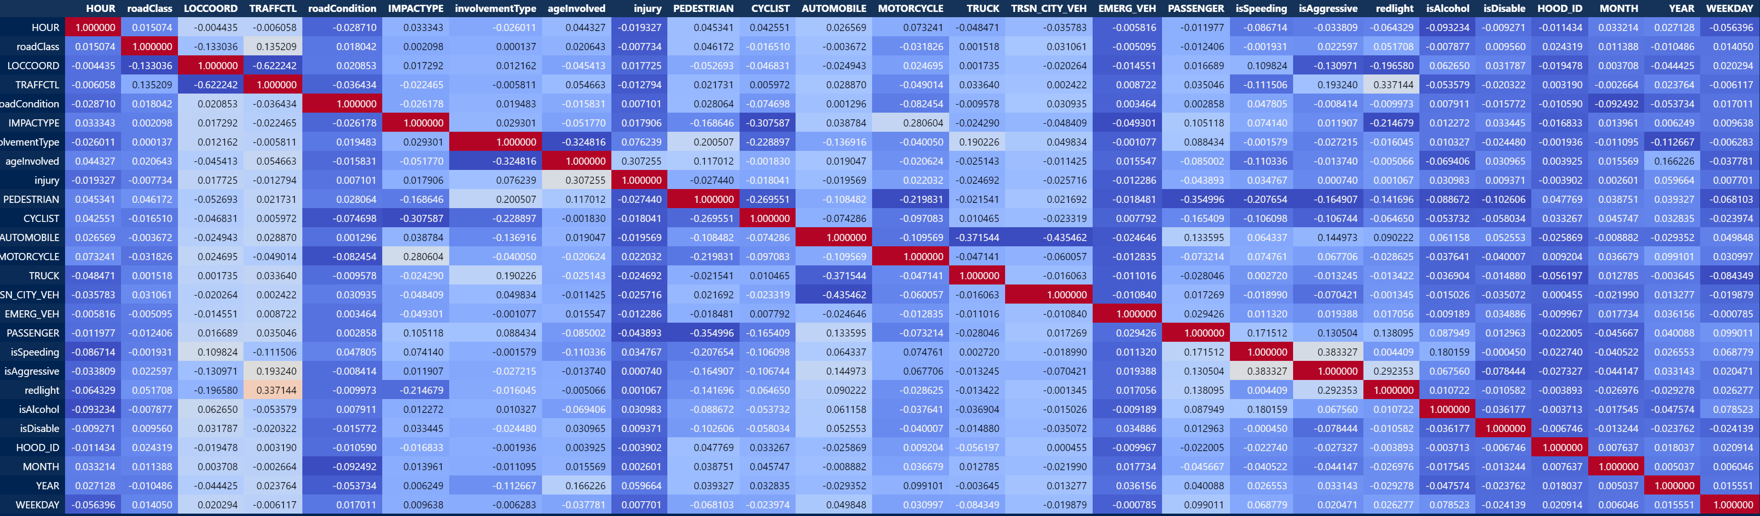
Correlation between Features

Slide 6
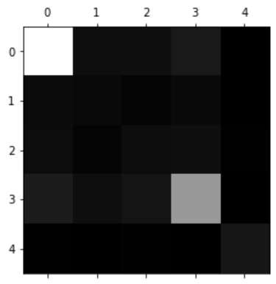
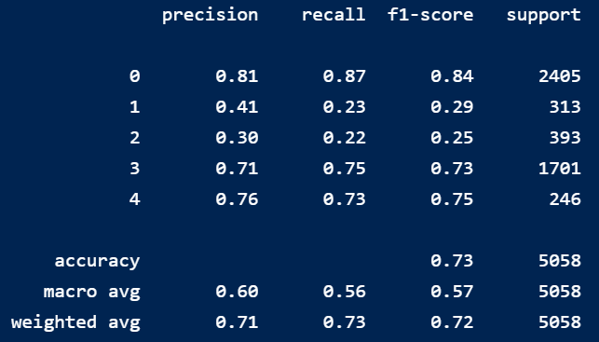
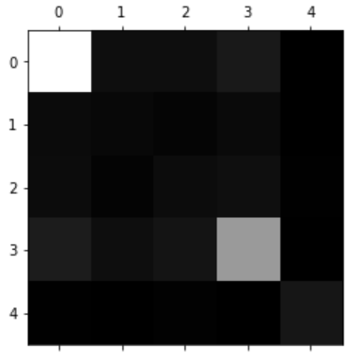
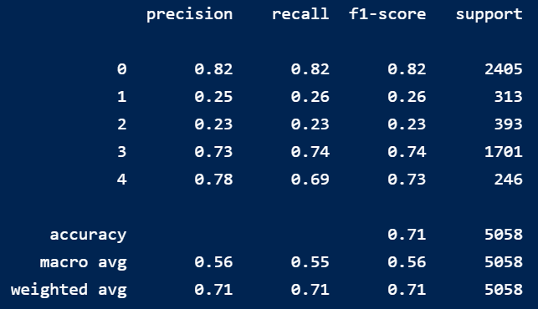
Models
Random Forest
Decision Tree
Observations
Observed to have the highest accuracy score when comparing against other models Might be the best option as we do not have to concern ourselves with underfitting/overfitting High dimensional data: Ideal as working with many subsets Ideal model due to its versatility, low bias (though high variance) and quick prediction speeds Able to get up to 0.77 accuracy score with hyperparameter tuning Both minor and minimal injury were difficult to predict with this model
Observations
Observed to have a decent accuracy score when comparing against other models Fast computational speed (efficiency) Versatile (Utilized for Numerical, Boolean or as is in this case categorical data Able to get up to 0.76 accuracy score with hyperparameter tuning Both minor and minimal injury were very difficult to predict with this model

Slide 7
Models
Model | Accuracy Score | Observations
AdaBoost Classifier | 0.65 | Low/Mid accuracy score Generalizes better for large populations as seen in KSI dataset
SVM classifier | 0.48 | Low accuracy score Might not be the best model due number of records and similarities between dimensions Computationally inefficient. Took longer to run than other models
KNN | 0.62 | Low/Mid accuracy score Intuitive approach based on storing the training set and being utilized only during real time predictions Computationally inefficient and difficult at times to get an accurate prediction of “k”
Logistic Regression | 0.56 | Lower accuracy score Beneficial due to the large number of records in dataset
SGD Classifier | 0.33 | Very low accuracy score
Naive Bayes | 0.48 | Low accuracy score
Voting Classifier | 0.72 | Higher accuracy score than majority of models Beneficial when models are showing high level of bias and can act like a generalized model Though the accuracy score is higher than some other models, it is not ideal due to ____

Slide 8
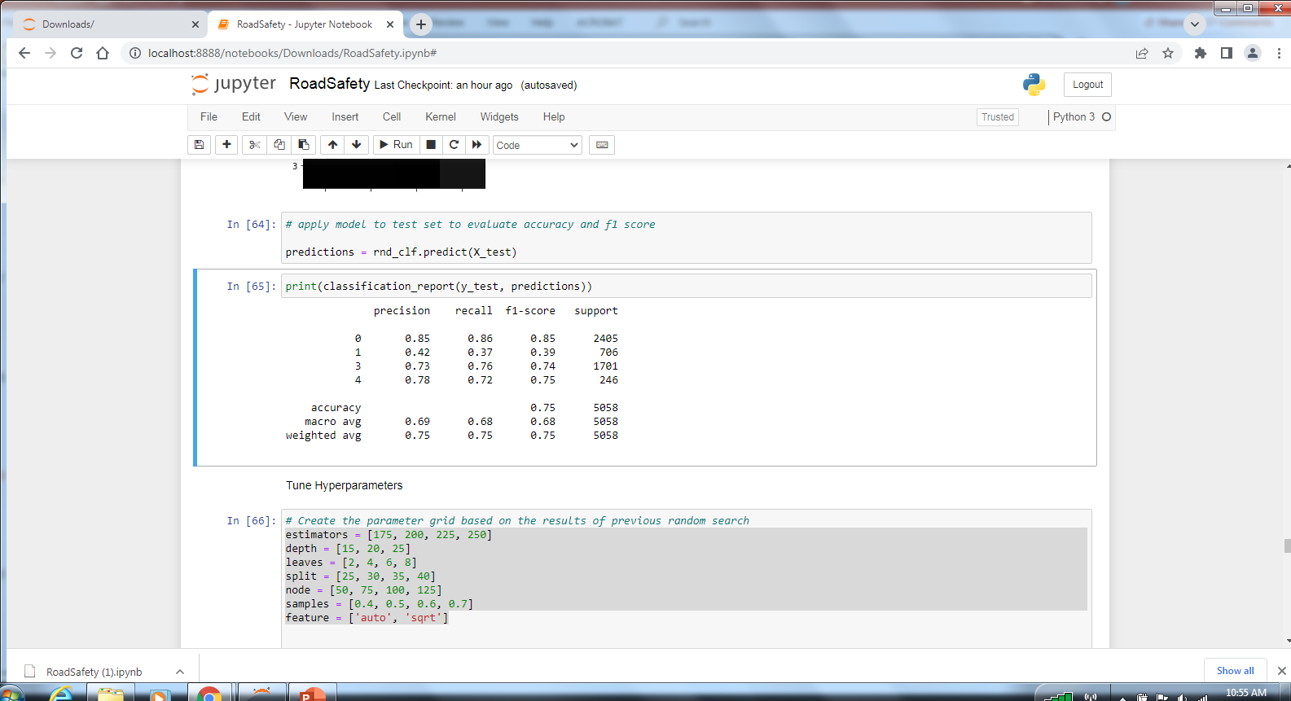
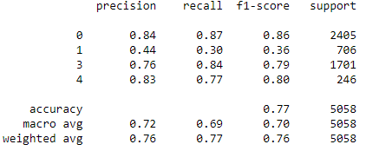
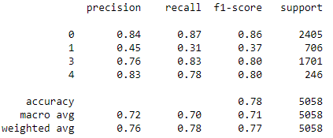
Fine Tuning – Random Forest
Tuned 7 hyperparameters within Random Forest
(n_estimators: 'max_depth ‘, min_samples_leaf ‘, min_samples_split ‘, max_leaf_nodes ‘, max_samples ‘, max_features)
Randomized search cv to search for the optimal parameters with the highest accuracy score
Continued tuning hyperparameters by narrowing down results with a lower range of numbers
Our observations concluded that despite additional hyperparameter tuning, there was minimal improvement in accuracy score.

Slide 9
Conclusion
Step | Observations
Data Cleanup | Realization: Binary features: null values are False Dropped features which had a considerable amount of missing data. Certain features within the dataset happened to overlap. To solve for this problem, we either dropped the column or merged it with another feature that included similar data.
Data Analysis | Created a heat map to determine which districts had the highest # of fatalities (Conclusion: Downtown Toronto, East York) Conducted analysis to determine the correlation between each feature when compared to one another (Conclusion: For the most part each feature was unique and not correlated, though there were a few which were slightly correlated (could be supported: Aggressive driving vs. Speeding)

Slide 10
Conclusion
Step | Observations
Models | Minimal and minor injury were difficult to predict for all models. Random forest would be the machine learning model for predictions. This is due to model’s versatility, low bias (though high variance), quick computational speeds and high dimensionality.
Hyperparameters | Conducted hyperparameter tuning for both decision tree and random forest models (highest accuracy score amongst models). After tuning, we determined random forest was the best model. (lack of bias, generalized, a collection of combined data trees)
In the real world, this data analysis and modelling would be helpful because….

